Slide 1


Analysing E-Commerce Order Rejection
MENTORED BY:
Mr. Mohit Sahu
SUBMITTED BY : GROUP NO. 8
Atharva Sadanshive
Diwakar Kaul
Govind T
Vishnu Prasad Shetty K S
Vinutha R

Slide 2


Overall Aim and Expectation:
To identity potential pain points in the delivery process.
Thereby reduce overall order rejection rates and hence cost to company.
Indirectly also improving the customer experience, hence increasing probability of customer retention.
Additionally, improve relationship with third party delivery vendors, since their rejection rates/costs would go down as well.

Slide 3
Dataset Description:
Classification problem
Size of data:24 columns and 129975 rows
There are 22 categorical columns and 2 numerical column
Challenges faced:
Outlier
treatment
Sampling Method
Imbalanced dataset

Slide 4
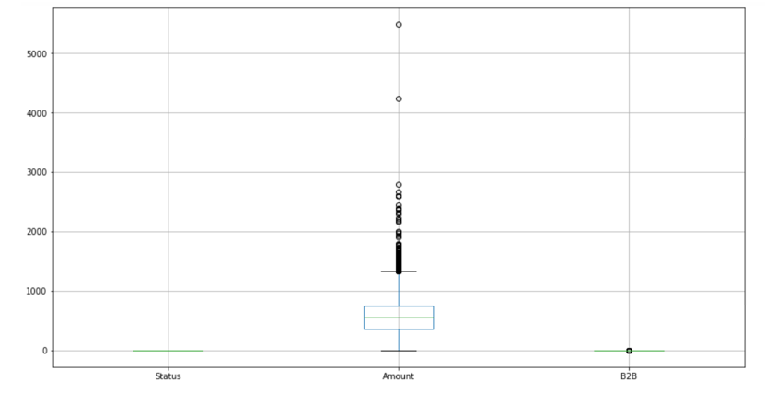
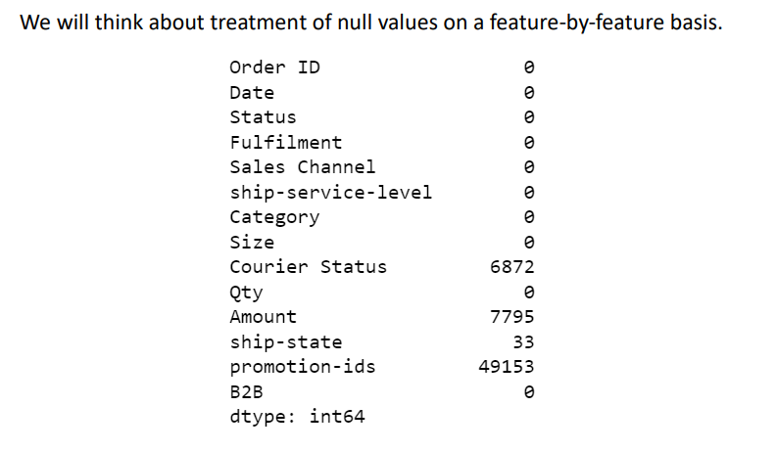
Null Values and Outliers:
Exploratory data Analytics:

Slide 5
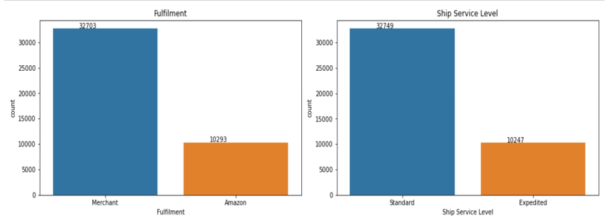
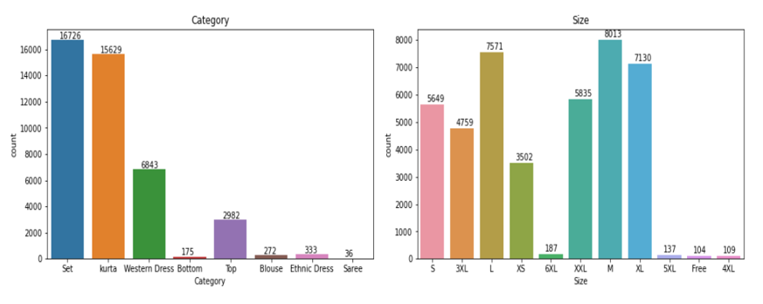
Analysis:

Slide 6
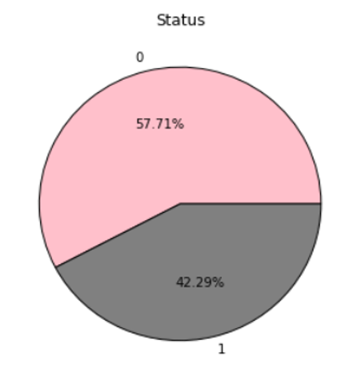
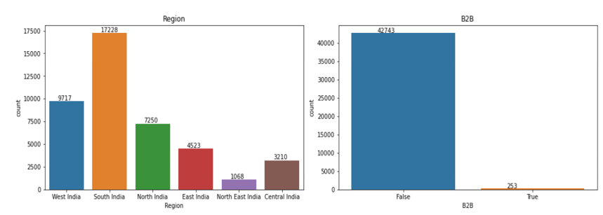

Slide 7


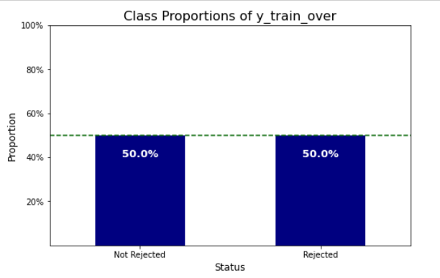
Base Model and scoring:
Using the Logistic Regression Classifier, we shall build our initial model and get a sense of its performance.
After scaling the numeric features and encoding the categorical features we have used the train_test_split function to procure appropriate train and test segments of the data to be fit into the model.
Additionally, we shall employ the imblearn library to address the class imbalance within the target set.

Slide 8
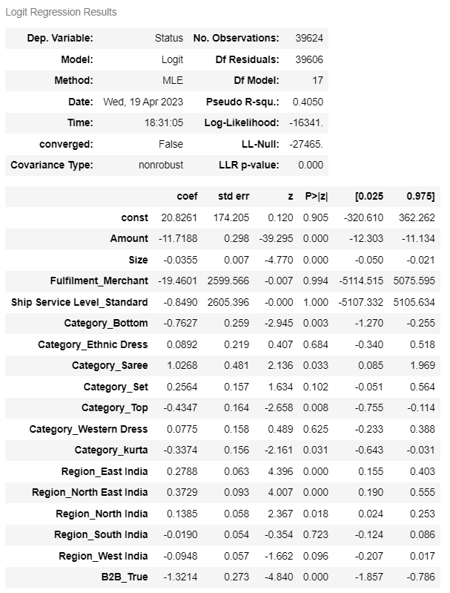
Base Model Performance Review

Slide 9
NEXT steps
Best Model
Cross Validation
Tuning hyperparameters
Additional Classifiers

Slide 10
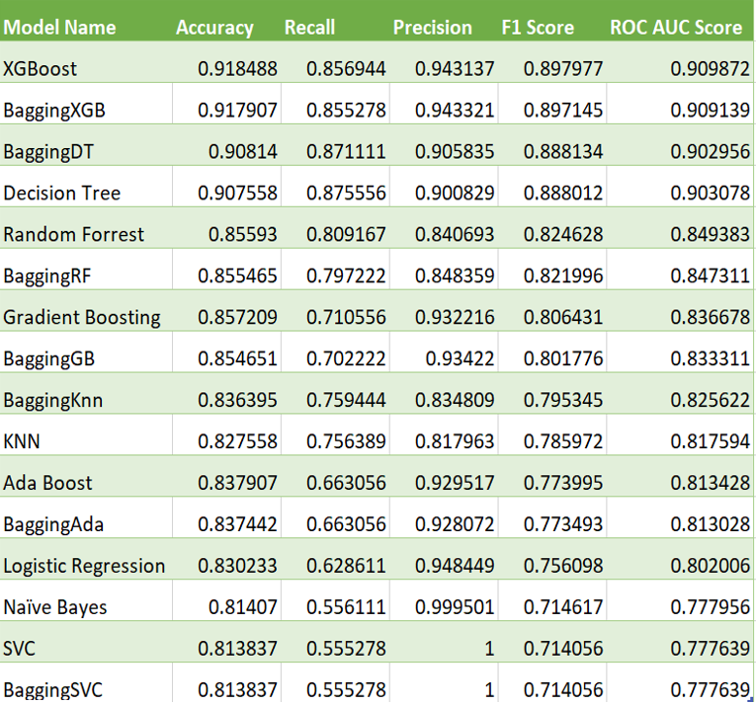
Scoring alternative models
Now that we have a overview of our base model’s performance, we shall run and score alternative models to verify whether any of those might prove superior in their prediction capability.

Slide 11
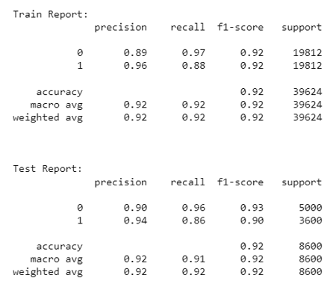
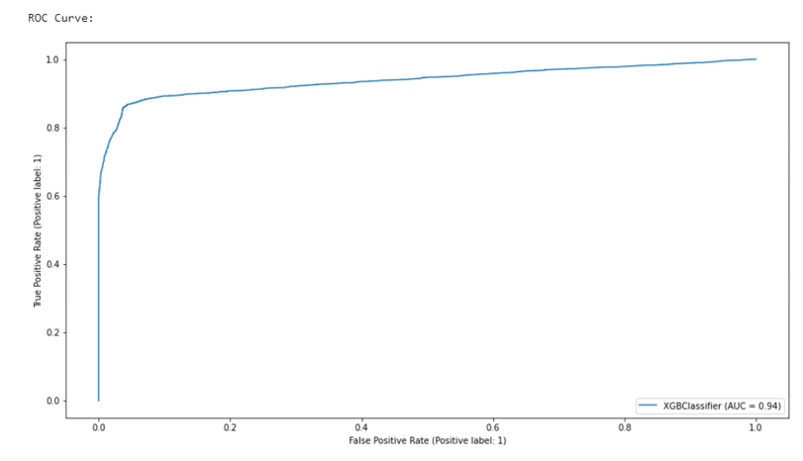
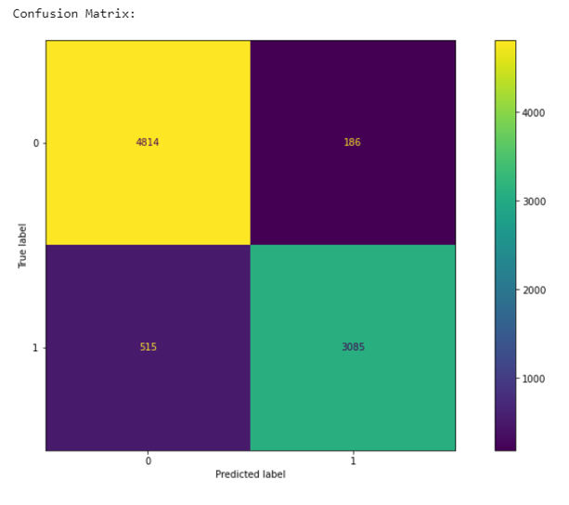
Performance overview for top models
XGBoost classifier, Bagging XGBoost classifier, Bagging Decision-Tree classifier, Decision Tree classifier and the Random Forrest classifier are seen to have, broadly speaking, displayed the best performance.
Let us look at each a bit more in-depth before making a decision on which model to finally select for further analysis and parameter tuning.
XGBoost classifier

Slide 12
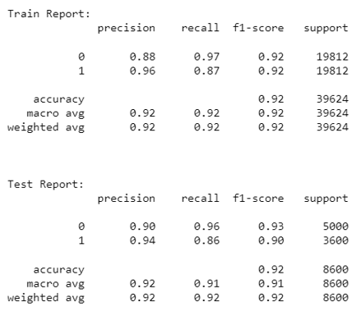
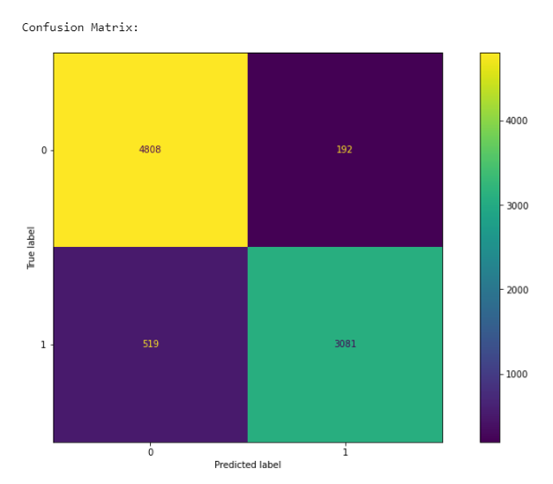
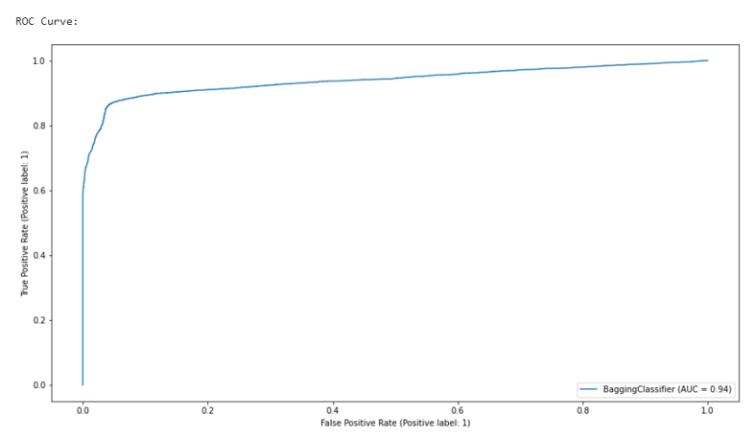
Bagging XGBoost classifier

Slide 13
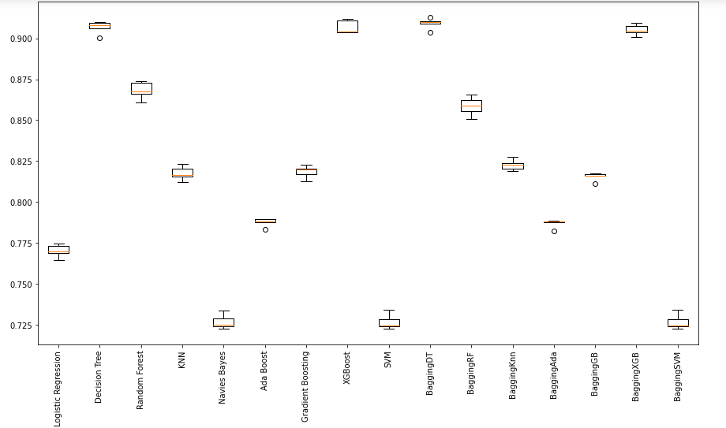
Error Rate Comparison of all Models:

Slide 14
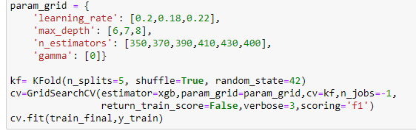

Final model – Hyperparameter tuning
We employed GridSearchCV to identify the most suited parameters for our selected XGBoost classifier model.
We are now able to use the below mentioned values to use as parameters and rerun the model.

Slide 15
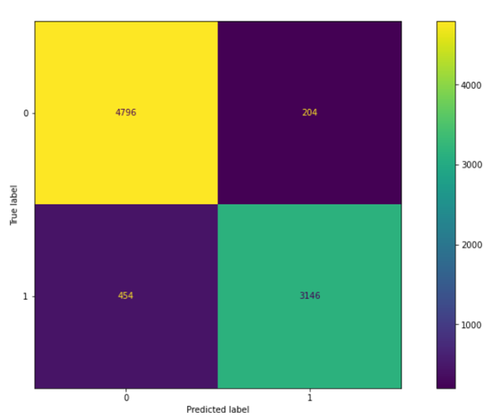
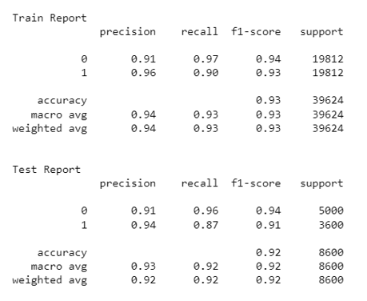
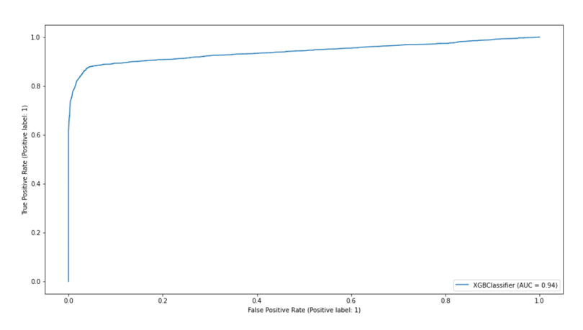
Final model evaluation (Post Hyperparameter tuning)

Slide 16
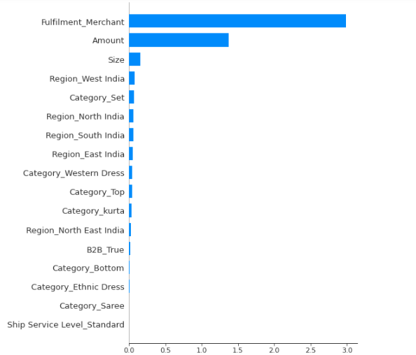
Final model - Key Notes and feature impact
In comparison to the base XGB classifier and alternative models, the hyper tuned XGB classifier model has shown a significant improvement in terms of reducing the false negative rate and improving the recall score.
Additionally, with a lower false positive rate, we can see an broad holistic improvement in model prediction performance and error reduction.
Overall, the fined tuned model had a better balance between precision and recall, and it performed significantly better than the base XGB classifier model.
Regarding effect on the model, the most important features are (Fulfilment, Merchant, Amount and Size). These features have the greatest impact on the predicted target variable, and should be given more attention when interpreting the model and making predictions.

Slide 17
Closing insights
Identification and further usage of the selected model. The XGBoost model with given parameters that gave is the highest performance scores, including F1 and ROC-AUC scores, has great potential to be used in deployment and processing and more recent order rejection data. Its relatively efficient computation should assist with easier implementation of the model.
Disparity among Amazon delivered and third-party delivered orders. Because of the extreme order cancellation distribution, with an over-whelming majority of cancellations occurring on orders delivered via third-parties, it is important to recognize that Amazon may have limited ability to effect change in the same that that it may have had, in case the pain points had occurred with Amazon delivered orders. Outside of warning or removing third-party merchants that continue to under-perform, there are limited changes that Amazon can force into effect. Nevertheless, insights gained through this analysis might prove quite useful to the third party merchants themselves, especially those that might be keen to improve their own record.
Focus on single-product purchases. It must be noted that while this model should prove to be quite useful in predicting and analyzing order rejection possibilities, in specific instance such as multi-product orders, the predictability performance of the model may differ.
Small B2B component. It is important to keep in mind that this dataset primarily refers to the B2B orders, and only has a very small B2B portion in the dataset. While our final model may still be acceptable to deploy on a B2B heavy dataset, confirmation of its performance on such a dataset will require testing.

Slide 18
THANK YOU

